Slide 1
Elkins High School School Policies
MISSION STATEMENT “Purpose, Pride, Perspective in Preparation for Tomorrow’s Leaders”

Slide 2
Warm weather is here! So we need to talk about……..

Slide 3
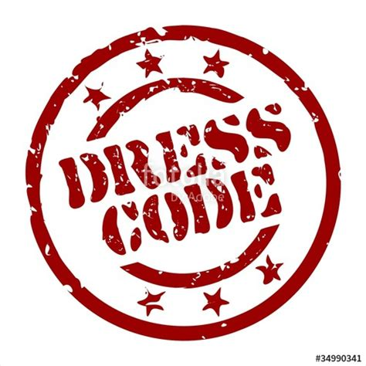

Slide 4
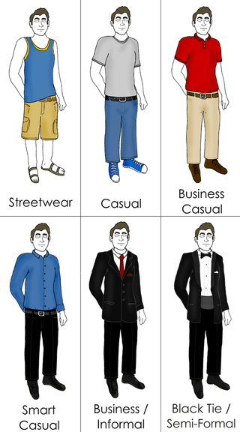
A dress code is a set of written and, more often, unwritten rules with regard to clothing. Clothing, like other aspects of human physical appearance, has a social significance, with different rules and expectations applying depending on circumstance and occasion

Slide 5
Prohibited:
Any insignia, markings, or ornamentation that advocates discrimination against a racial religious, minority, or gender group
attire with sexually implicit or explicit graphics
attire that advertises or encourages the use of alcohol, tobacco, or drug-related products
any accessory with spikes (raised or not); heavy chains; heavy bands around the neck; short shorts or short skirts

Slide 6
The length of shorts, skirts, and dresses are to be at the tip of the fingers, when arms are extended down the side
No cuts, slits, holes, etc. will be higher than this standard; pants below normal waistline; underwear showing; spaghetti strap tops, shirts with revealing enlarged armholes.
There should be no exposure between the top of the pants, shorts, etc. and the shirt. If normal movement (walking, bending, twisting, etc.) causes exposure, the attire is not appropriate. The “square rule” will be used to determine what shirt is appropriate.

Slide 7
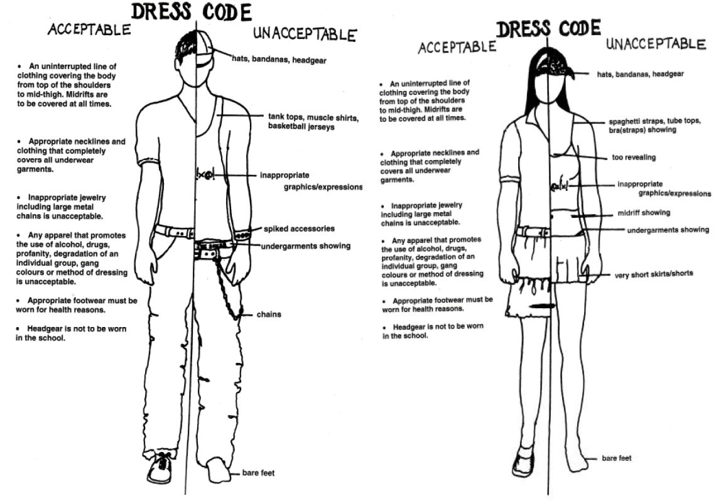

Slide 8
Students will be provided with an opportunity to comply with the dress code.
Non-compliance with school rules will result in parent notification to bring clothes to school or (student will be sent home only if they refuse to comply).
Time out of class will be an unexcused absence.
Repeat violations of this Dress Code could result in 1 day of Lunch Detention.

Slide 9
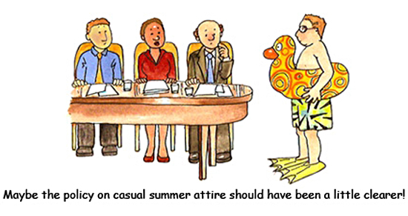

Slide 10
Also…….No PDA in the hallways! (Personal Display of Affection)

Slide 11
Elkins High School School Policies
Inappropriate Display of Affection
Students will not engage in inappropriate displays of intimate affection, such as kissing or embracing.

